Slide 1

CLOUD COMPUTING
ANALYTICS

Slide 2
CLOUD COMPUTING ANALYTICS
Taxi Analytics Deployment on GCP
Guided By –
Prof. Vishal Meshram
Group Members
Name | Roll No. | PRN | Email - Id
Amey Bhirange | 373005 | 22110073 | amey.22110073@viit.ac.in
Saloni Dhurandhar | 373012 | 22110034 | saloni.22110034@viit.ac.in
Nikhil Dongare | 373015 | 22110412 | nikhil.22110412@viit.ac.in
Shreyas Kharche | 373023 | 22110063 | shreyas.22110063@viit.ac.in

Slide 3
TABLE OF CONTENTS
01
Introduction
03
Architecture
02
Objectives
04
Conclusion

Slide 4

01
Introduction

Slide 5

INTRODUCTION
This project is centered around performing impactful data analytics on taxi-related data. It employs an integrated approach utilizing GCP Storage for efficient data management, Python for data manipulation, Compute Instances for computational tasks, Mage Data Pipeline Tool for streamlined workflows, Big Query for powerful data querying, and Looker Studio for insightful visualizations. By combining these tools and technologies, the project aims to derive meaningful insights from taxi data, enabling informed decision-making and a comprehensive understanding of the data landscape.

Slide 6


02
Objective

Slide 7

Objectives
Integrated Workflow :
Harmonize GCP Storage, Python, Compute Instances, Mage Data Pipeline Tool, Big Query, and Looker Studio for seamless data processing.
Actionable Insights:
Extract meaningful patterns and trends from taxi data for a comprehensive understanding.
Decision Empowerment
Equip stakeholders with insights for informed decision-making, optimizing taxi-related operations

Slide 8
1.Jupyter Notebook
2.Lucid App
GCP
1.Compute Instance
2.Cloud Storage
3.Big Query
Services Used
MAGE Data Pipeline Tool
Google
Looker Studio

Slide 9
Architecture
01
02
04
05
Raw Data
Cloud storage
Mage VM
Compute engine
Analytics
Big Query
Dashboard
Looker Studio

Slide 10
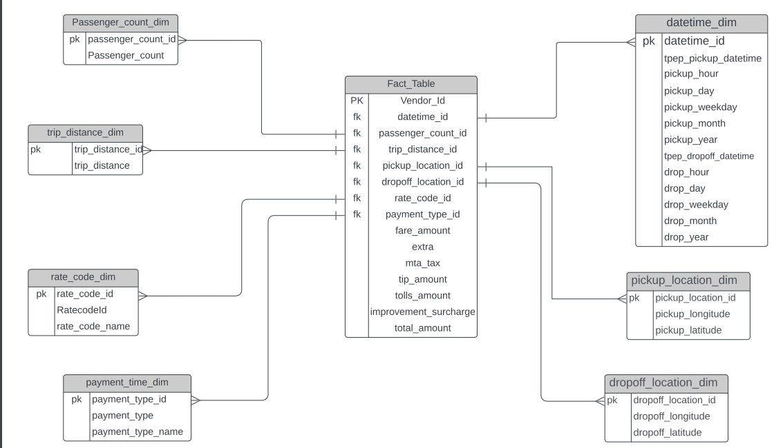
Data Model

Slide 11
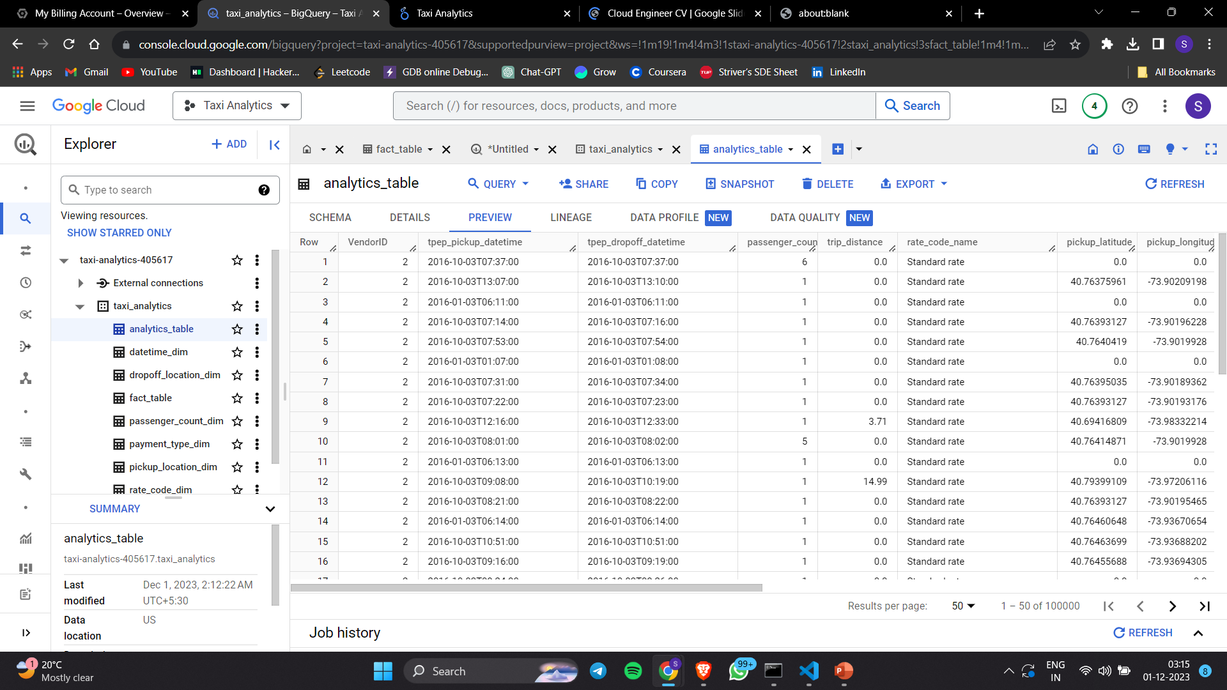
Implementation

Slide 12
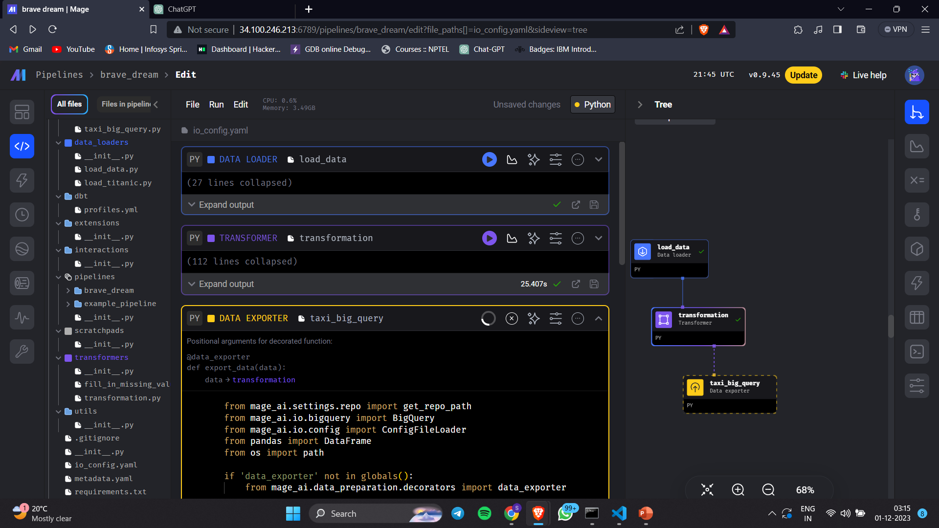
Implementation

Slide 13
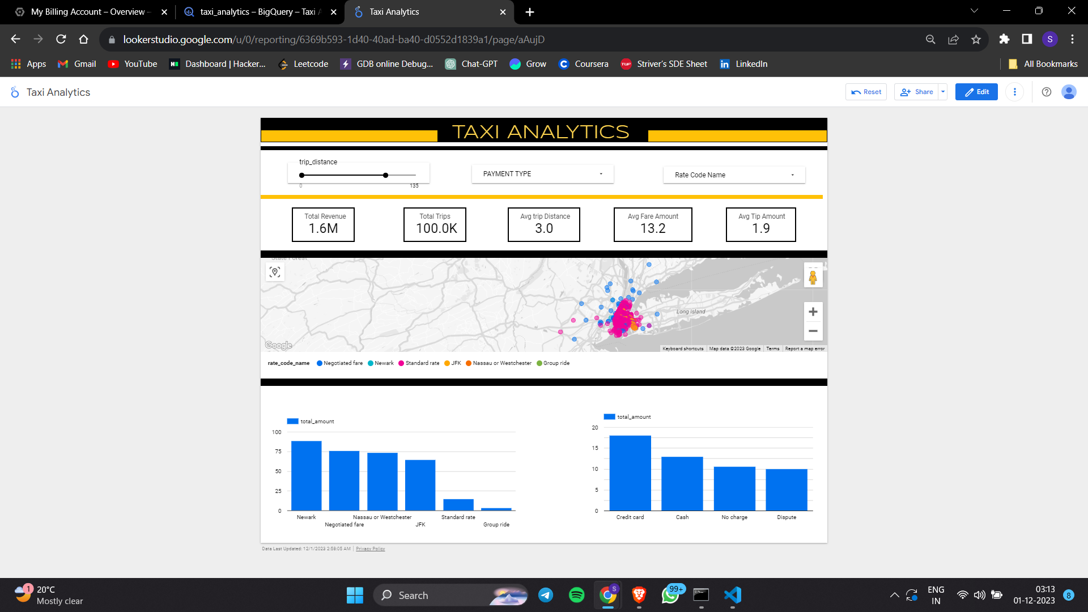
Implementation

Slide 14
Conclusion
1. Operational Optimization:
Highlight how the integrated approach has contributed to optimizing operational processes in the taxi-related data landscape.
2. Strategic Impact:
Showcase how the derived insights have the potential to strategically impact decision-making in the taxi industry.
3. Experience of different cloud services and how it can revolutionaries the data analytics industry

